Slide 1
Week 06:
Wireshark Tutorial
Computer Networks Lab

Slide 2
What is Wireshark?
It is an open source packet analyzer
It is is used for education, analysis, software development, communication protocol development, and network troubleshooting
It is commonly called as a sniffer, network protocol analyzer, and network analyzer
It is free to use application

Slide 3
Uses of Wireshark
It is used by network security engineers to examine security problems
It allows the users to watch all the traffic being passed over the network.
It is used by network engineers to troubleshoot network issues
It also helps to troubleshoot latency issues and malicious activities on your network
It can also analyze dropped packets
It helps us to know how all the devices like laptop, mobile phones, desktop, switch, routers, etc., communicate in a local network or the rest of the world

Slide 4
What is Packet?
It is a unit of data which is transmitted over a network between the origin and the destination. Network packets are small, i.e., maximum 1.5 Kilobytes for Ethernet packets and 64 Kilobytes for IP packets. The data packets in the Wireshark can be viewed online and can be analyzed offline.

Slide 5
Features of Wireshark
It is multi-platform software, i.e., it can run on Linux, Windows, OS X,etc.
It is a standard three-pane packet browser.
It performs deep inspection of the hundreds of protocols.
It often involves live analysis
It has sort and filter options which makes ease to the user to view the data
It has countless applications ranging from the tracing down, unauthorized traffic, firewall settings, etc.

Slide 6
Installation
Open the web browser.
Search for 'Download Wireshark'
Select the Windows installer according to your system configuration, either 32-bit or 64-bit
Save the program and close the browser
Now, open the software, and follow the install instruction by accepting the license
The Wireshark is ready for use.
If you are Linux users, then you will find Wireshark in its package repositories.

Slide 7
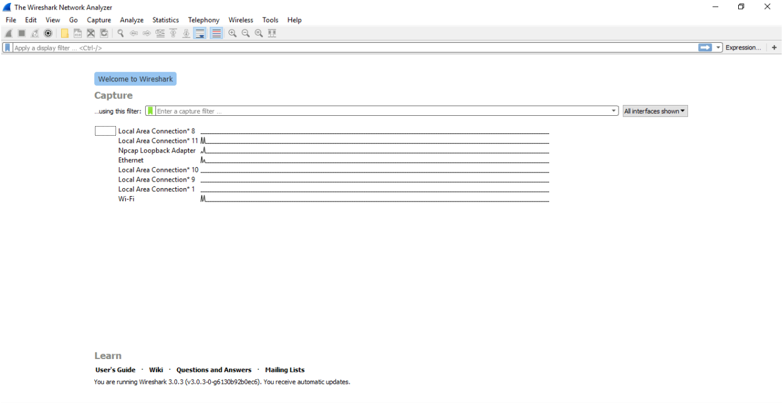

Slide 8
If we select Wi-Fi option from the interface list options, new window shows all the current traffic on the network. This shows the live captures of packet.

Slide 9
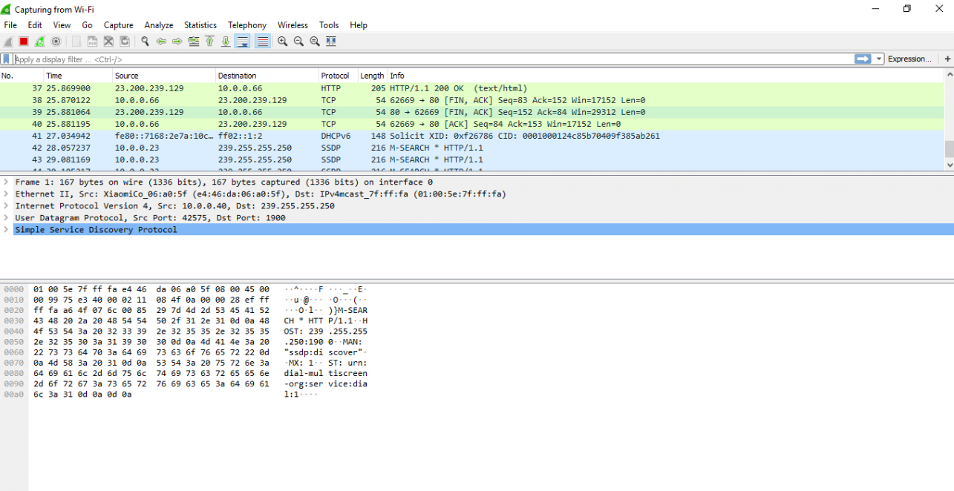
4. Filter field e.g if you want to view http packets only
1. Live capture of packets
2. Details of packet header of selected packet
3. Packet content written in hexadecimal and ASCII format

Slide 10
Lab Task
Open wireshark and start capturing the traffic.
Search for ‘gmail’ on internet and log in to your account.
Stop capturing the traffic and display ‘http’ traffic. Then search for tcp and dns too.
Write down the IP address of your machine and the IP address of destination server.
Write down source and destination port number of one http packet.
Figure out the coloring rules of wireshark from view on toolbar.
Submission: Word document containing screenshot of each question

